Slide 1

Web Development
Tasks
Presentation
By:
Shraddha Choche
Web Development
December B1

Slide 2


Table of Contents
Acknowledgement
2. Beginner Level
3. Conclusion

Slide 3
Acknowledgement
I express my sincere gratitude to ShadowFox for providing this valuable web development internship opportunity that has significantly contributed to my technical and professional growth. I am especially thankful to my internship coordinator, Mr. Aakash S, for his continuous guidance, support, and mentorship throughout this journey. His insights and encouragement were instrumental in helping me navigate challenges and complete the assigned tasks effectively.

Slide 4
Beginner Level Task - Description
To Build Personal Portfolio Website
Required Sections:
Home/Introduction page with professional bio
About Me section with background information
Skills showcase with technical competencies
Project portfolio with work samples
Resume/CV download section
Contact information with functional form
Key Requirements:
Fully responsive across all devices
Interactive elements and smooth navigation
Visually appealing modern design
Cross-browser compatibility
Accessibility standards compliance
Clean and maintainable code structure

Slide 5

Objectives
1. Develop Proficiency in HTML and CSS Master HTML5 semantic elements and CSS styling techniques for creating static web pages with modern layouts.
2. Build Personal Portfolio Website Create a comprehensive portfolio showcasing skills, projects, resume, and contact information in an organized manner.
3. Implement Basic JavaScript Interactivity Add interactive features like smooth scrolling, form validation, and dynamic content to enhance user engagement.
4. Ensure Responsive Design Make the website accessible and functional across various devices (mobile, tablet, desktop) using media queries.
5. Learn Version Control with GitHub Create and maintain a GitHub repository for code management, documentation, and project organization.

Slide 6
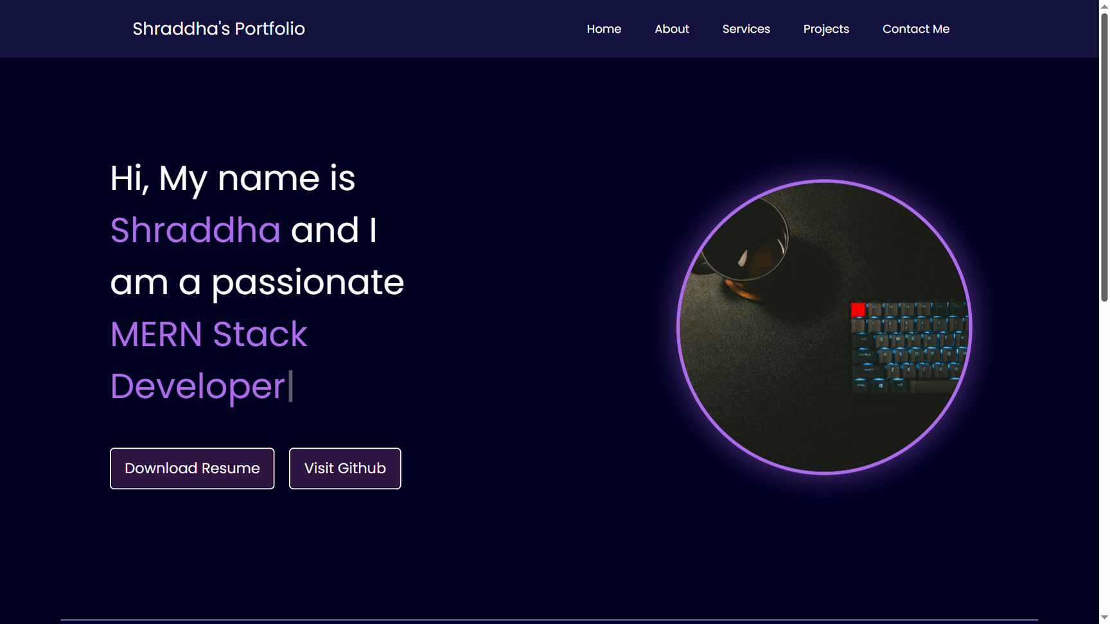
Practical Implementations

Slide 7
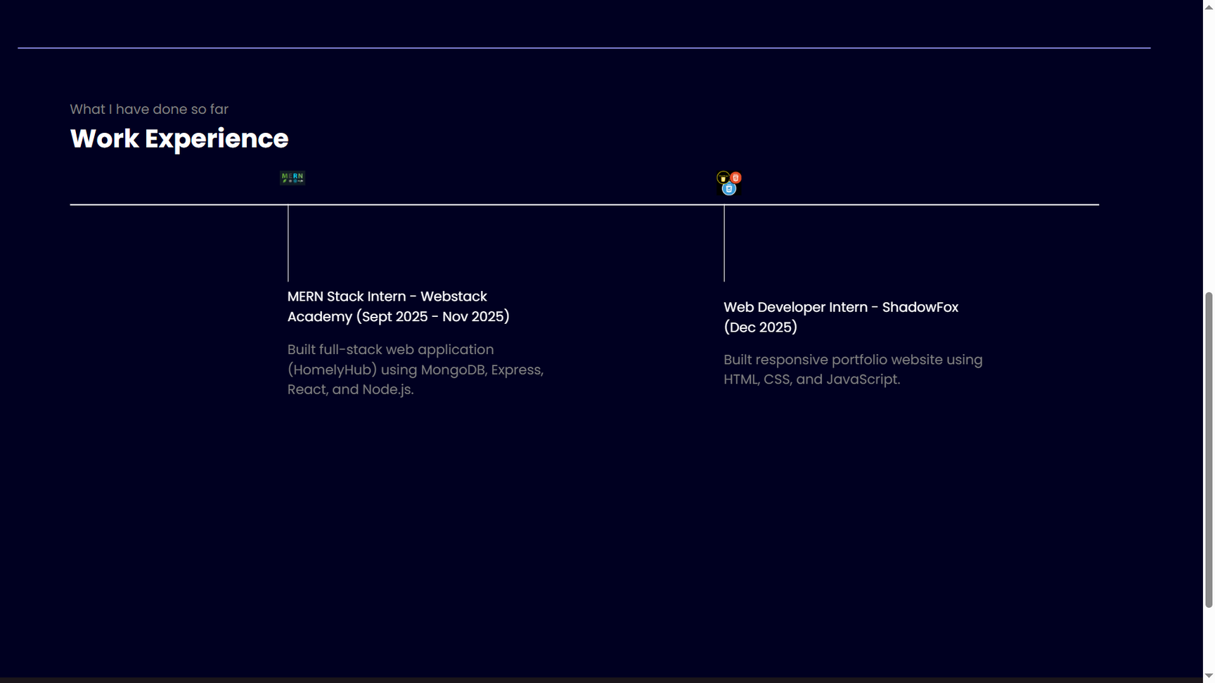
Practical Implementations

Slide 8
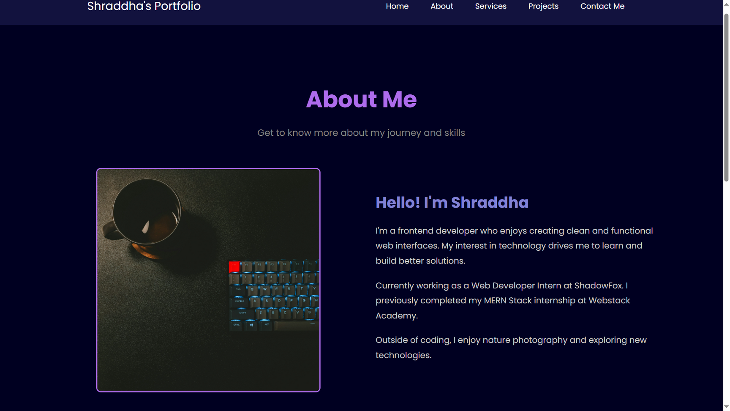
Practical Implementations

Slide 9
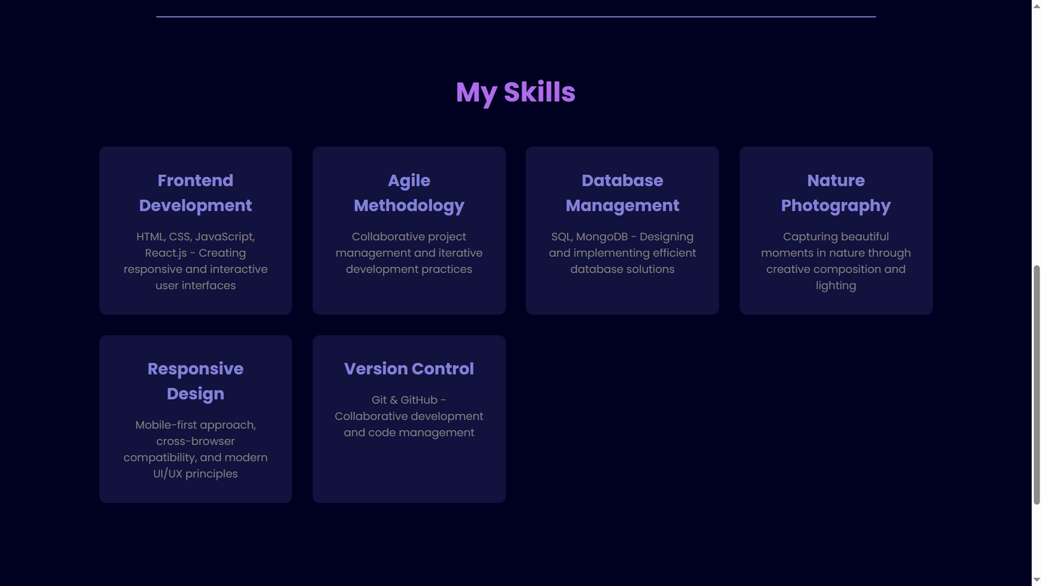
Practical Implementations

Slide 10
Learning Outcomes
Technical Skills Acquired:
Gained practical proficiency in HTML5 semantic elements, CSS styling capabilities including flexbox, grid layouts, and responsive design using media queries
Implemented basic JavaScript for interactive elements such as smooth scrolling, form validation, and dynamic content display
Learned version control fundamentals through Git and GitHub repository management
Professional Development:
Enhanced understanding of web accessibility standards, cross-browser compatibility, and developed problem-solving skills through debugging
Improved attention to detail in creating visually appealing and user-friendly interfaces
Strengthened documentation and presentation skills through creating proof-of-work materials for professional networking platforms

Slide 11
Conclusion
The beginner-level task of creating a personal portfolio website provided a solid foundation in web development fundamentals. Successfully delivered a fully functional, responsive, and visually appealing website that effectively showcases skills, projects, and professional information. This experience reinforced the importance of clean code, user-centric design, and thorough testing across multiple platforms. The internship experience has not only enhanced technical competencies but also improved professional documentation and communication skills essential for a successful career in web development.

Slide 12
Thankyou!!

